Slide 1
Employee Data Analysis using Excel
STUDENT NAME :Pavithra.S
REGISTER NO :122204270
DEPARTMENT :BCom corporate secretaryship
COLLEGE :Govt Arts & Science College(Tondiarpet)
CODE : 1683
satjays85@gmail.com

Slide 2
PROJECT TITLE
Employee Performance Range Analysis using Excel

Slide 3


AGENDA
Problem Statement
Project Overview
End Users
Our Solution and Proposition
Dataset Description
Modelling Approach
Results and Discussion
Conclusion
3/21/2024 Annual Review

Slide 4


PROBLEM STATEMENT
The objective is to categorize employee performance into distinct ranges, helping in effective performance management and decision-making.its method gives employee performance range good or low .
Without a clear evaluation system, it's challenging to identify top performers and address underperformance. Categorizing performance helps ensure fair evaluations, consistent feedback, and better development strategies. This structured approach also supports transparent performance reviews, contributing to overall organizational growth.

Slide 5

PROJECT OVERVIEW
We used Excel to classify employee performance using a predefined rating system: 1 for "Very Low," 2 for "Low," 3 for "Good," 4 for "Very Good," and 5 for "Excellent." Pivot tables and charts were created to summarize and visualize the data.
By leveraging Excel's built-in functions and visualization tools, we created an efficient and user-friendly process for evaluating and presenting employee performance data. This approach is easily scalable and adaptable to various team sizes and organizational needs

Slide 6


WHO ARE THE END USERS?
This analysis is designed for HR managers and team leads to evaluate employee performance and support decisions on promotions, rewards, and employee development.

Slide 7

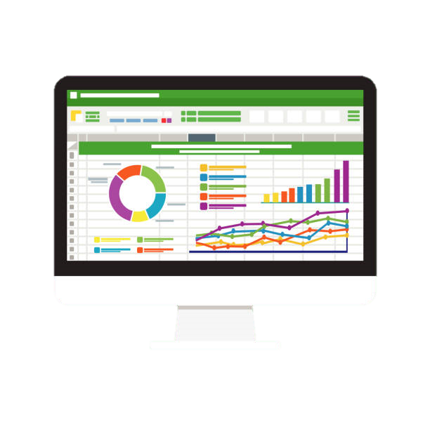
OUR SOLUTION AND ITS VALUE PROPOSITION
We applied an IF function in Excel to assign performance categories based on the ratings, followed by the creation of pivot tables and charts to present the data effectively.

Slide 8

Dataset Description
The dataset includes employee IDs and performance ratings, with each employee assigned a performance range from "Very Low" to "Excellent" according to the rating system. The dataset not only includes employee IDs and performance ratings but may also incorporate additional variables like department, job role, and tenure. These supplementary data points can be used to perform deeper analysis, such as identifying trends in performance across different departments or experience levels. By enriching the dataset with this information, the analysis becomes more robust, offering insights that can guide targeted interventions and strategic decisions in talent management. This comprehensive approach ensures that the performance evaluation is both detailed and contextually relevant

Slide 9


THE "WOW" IN OUR SOLUTION
=IF(Z2=1,"Very Low",IF(Z2=2,"Low",IF(Z2=3,"Good",IF(Z2=4,"Very good",IF(Z2=5,"Excellent","")))))
The "wow" factor in our solution lies in its simplicity and effectiveness. By using Excel-a tool that is readily available and familiar to most users-we've created a powerful system for categorizing and analyzing employee performance without the need for specialized software. The integration of dynamic formulas, pivot tables, and visual charts allows for real-time updates and easy interpretation of the data.
3/21/2024 Annual Review
9

Slide 10

MODELLING
*Dynamic Updates*: Real-time updates allow for instant reflection of changes in performance ratings.
*Customizable Metrics*: The model can easily adapt to different performance indicators based on organizational needs.
*Comparative Analysis*: Supports analysis across demographics, helping identify trends and areas for improvement.
*User-Friendly*: Designed for accessibility, enabling users of varying Excel proficiency to navigate effectively.
*Data-Driven*: Promotes data-driven decision-making, fostering accountability and continuous improvement.
Excel formulas were used to determine the performance range, with pivot tables summarizing the data and charts providing a visual representation of the performance distribution
10

Slide 11

RETSULS
The key results of the performance range analysis highlighted the distribution of employee performance across different categories, identifying top performers, average employees, and those requiring further development. The visual representation via charts allowed for easy comparison between departments and teams, revealing specific areas where additional training or resources might be needed. The analysis also helped in recognizing patterns of excellence, enabling the organization to replicate successful strategies in other areas.
11

Slide 12

conclusion
This method allows for easy identification of both top performers and those needing improvement, aiding in strategic decision-making for employee development and retention.
Enhanced Decision-Making: The analysis empowers managers with clear insights, leading to more informed decisions on employee promotions, training, and development.
Organizational Growth: Ultimately, this structured performance analysis contributes to overall organizational growth by fostering a culture of continuous improvement and development.

